Slide 1
Housing – Status Review and Some Proposals
By
Dr. Noman Ahmed

Slide 2
Reliable quantitative data and situation analysis about the recent housing status in Pakistan is not available.
Extrapolation of 1998 census and other studies are the only means.
Population, housing and other forms of census exercises are long due. It is feared that due to ongoing flood disasters, political inaction and potential discord amongst decisions making echelons, this delay shall be stretched further.

Slide 3
A DEFINITION OF HOUSING
Housing is a process. It has many ingredients. The important ingredients in the Pakistani context include land, infrastructure, building materials, technology and means of access (to housing).

Slide 4
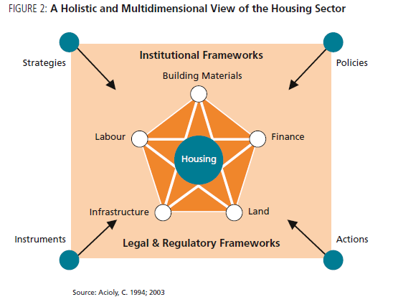

Slide 5
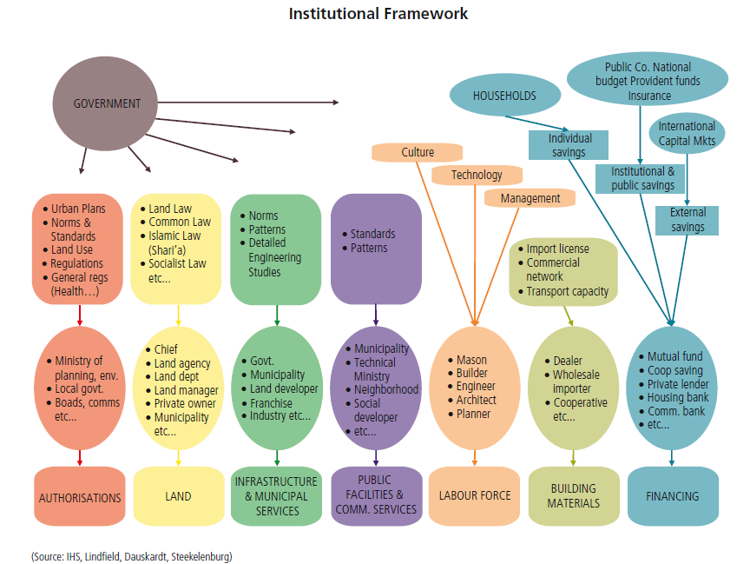

Slide 6
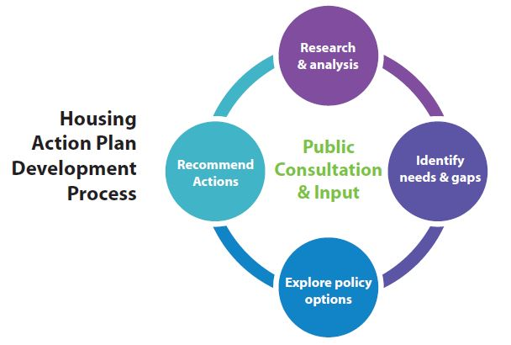

Slide 7
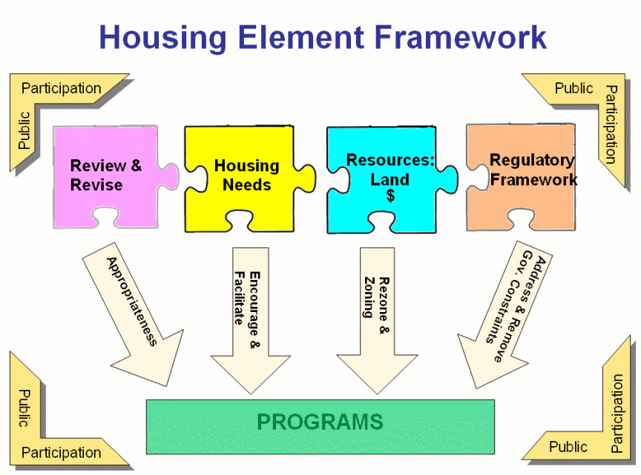

Slide 8
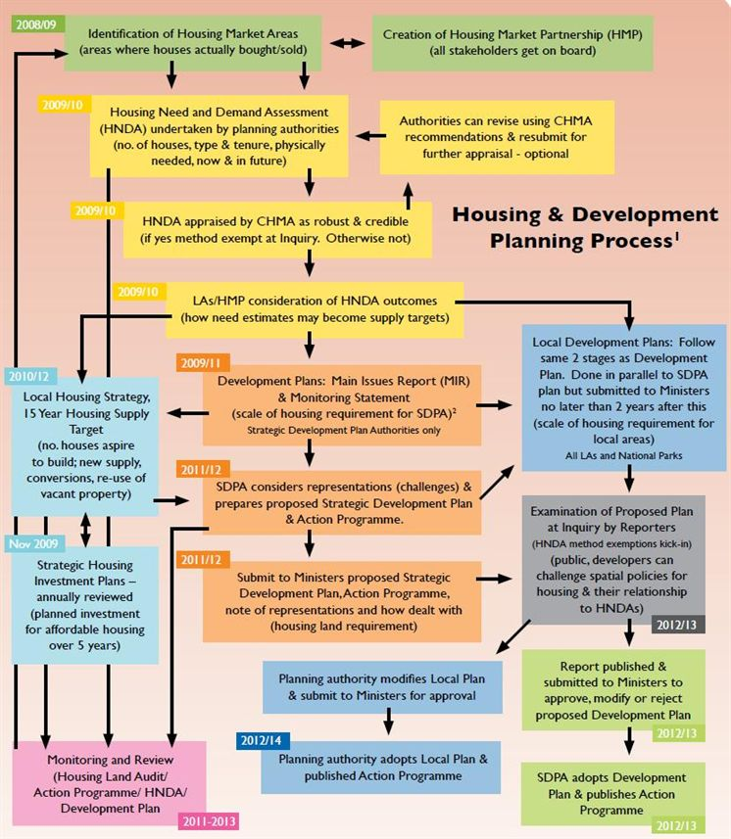

Slide 9
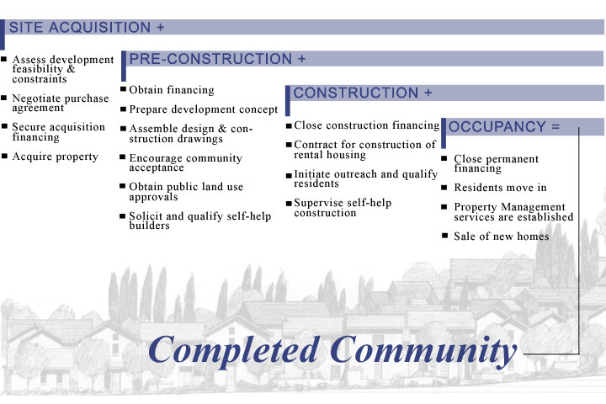

Slide 10
Housing is the third most essential human need after food and clothing.
Housing is related to the larger issues such as employment, transportation, health and education facilities.

Slide 11
PAKISTAN’S HOUSING NEEDS
Depend on
Natural growth need
Migratory needs
Backlog
Replacement/disaster affected
Total urban housing need in the country is over 2.7 million units (pre-flood situation)

Slide 12
A CHRONOLOGICAL REVIEW OF POLICY
ATTEMPTS IN HOUSING
1949
Newly formed Ministry of Rehabilitation was entrusted the responsibility of housing the refugees. Locations identified. Blue prints made for refugee colonies and displaced people’s townships.
1955-60 First Five year Plan
  Major emphasis was laid on housing. 10 percent of public sector spending was allocated for the purpose.
  Government focused on direct inputs/expenditures in the housing sector.
1960-65 Second Five Year Plan
  Approach remained the same as first five-year plan. Government remained directly involved in the planning, execution and management of the housing.
  Shortfall started appearing in urban sectors. First generation of squatter settlements became prominent as a repercussion of policy failure.

Slide 13
1965-70 Third Five Year Plan
  Private sector was encouraged to participate in housing development. Tax incentives were provided.
  Government spending shrank. Public funds were diverted to the construction of capitals in Islamabad and Dhaka.
Fourth and Fifth Five Year Plan
  maintained emphasis on public sector control of housing development. Land development and allocation was a key control in this respect. Credit facilities from HBFC started expanding.
1983-88 Sixth Five Year Plan
  Sharp decline appeared in housing related public investment. Policy makers concluded that housing is a capital intensive exercise where government alone cannot play a direct role.
  However land allotment and supply remained tightly controlled by the government.

Slide 14
1988-93 Seventh Five Year Plan
  Support to housing process. Government formally recognized the informal housing/squatters programmes for katchiabadi upgradation formed. Informal supply of land was thus formally accepted.
1993-98 Eight Five Year Plan
  Aimed at increasing the provision of land. Land acquisition programmes were planned for local agencies.
  Comprehensive land information system was planned.
  Reforms in land registration laws were proposed.
1998-2003 Ninth Five Year Plan
  Emphasis on private sector participation.
  Reduction in the direct support of the government in housing provision.

Slide 15
National Housing Policy 2001
- Recognition of prevailing housing conditions in the country.
- Emphasis of implementation on local bodies.
- Federal government limiting its role to a ‘facilitator’.

Slide 16
Housing In Pakistan – Some Indicators
Overall population increasing at 2.6 percent. Urban population increasing at 4.7 percent. Housing need evolves as a corresponding measure.
No. of households increasing at a rate of 2.86 percent of the existing due to changing family structures.

Slide 17
45 percent population in urban Sindh and 50 percent in urban Punjab lives in one room house.
Only 53 percent have access to a water source in urban Pakistan, not necessarily drinkable.
25 percent have access to sanitation.

Slide 18
Priority Target Group For Housing Policy Input
Ample means to access housing options available in the market.
High income group
Middle income group
Able to mobilize resources to access housing options in the market.
Low income group
Unable to access housing options.

Slide 19
In deeply located rural areas, the conventional access to land for housing is under stress. Fragmentation of land holdings under inheritance based distribution, resort to an intensely practiced cash transactions, shrinking of community land assets and gradual dislocation of artisans from rural communities has led to a changed scenario in sizable rural contexts.
Densification of inner cities are another option that is commonly found in the cities. Development of multi storey blocks with residences on upper storeys and commercial space at the lower levels is a common sight.

Slide 20
Two distinct patterns of housing development are found in small and medium sized cities. Housing for affluent class is organized on land parcels allocated by local land owners. They are sub divided and utilized for house building according to specific requirements of prospective occupants. This approach functions both in the formal and informal manner. For poor and lower middle income people, smaller sub divisions of land are facilitated to reduce the cost.

Slide 21
LAND
Land has become a commodity that is trans actable in the market. It is no more considered as a social asset.
Land supply for housing cannot be governed by the government alone. Role of formal and informal private sector has become extremely vital.
Land markets have become a strong recipient of capital investment. Fluctuations, anomalies and poor performance of other markets is one reason in this reference.

Slide 22
PLANNING AND DEVELOPMENT
Lower income groups build houses incrementally according to needs, scales of affordability and social conditions.
Formally constructed housing stock is unaffordable and inaccessible for the poor due to high initial cost and modes of payments incompatible with the status of the poor.

Slide 23
Objectives and interests in large scale undertakings initiated by public sector do not correspond to the prevailing problems in housing sector. Prime Minister Housing Schemes, recently announced town of Zulfiquarabad and Benazir Housing Support Programs are cases in point.

Slide 24
FINANCE
No credit facilities exist for the urban poor in the formal banking structure. Credit is essentially tied with collateral, which excludes all those who do not possess any land title or proof of ownership for land.
No credit support mechanism exists for providing urban poor the access to land market. All the emphasis lies on house construction loans.
Loans of small amounts are not granted by financial institutions. Urban poor usually need loans of a few thousand rupees only.

Slide 25
Urban sprawl and extension of low density low rise development promotes speculation and diminishes the utilization of geographically advantageous locations in cities. The urban rich live close to city centers or major places of employment while urban poor reside along urban edges and peripheries. Zoning laws and building regulations do not respond to these grave issues. Market mechanism determines the locational choices for housing development.

Slide 26
Access to housing in large cities is ensured according to nascent market mechanism. Land, construction materials, linkage to services and labor / consultancy / contracting, transaction are cash based.
The poor are being pushed to distant peri urban locations which substantially increase commuting cost.

Slide 27
Investment in housing as a real estate enterprise can be greatly enhanced if rental housing scenario is reformed. Whereas the figures show a rise in the proportion of rental housing, very little change has been seen the legal and regulatory mechanisms of this sub-sector. Obsolete laws, faulty and inadequate enforcement, high risks in cases of usurpation of properties and flawed mechanisms of rental ceiling ascertainment are some handicaps. Inefficiencies and inadequacies need to be eradicated from this sector through policy and procedural reforms.

Slide 28
A large number of stakeholders who support housing provision do not have any recognition in the main stream policy / decision making apparatus in housing. Real estate agents, patwaris, informal land developers, private builders, labour contractors, small scale material suppliers and community action groups (that manage settlements) are some references.
Unavailability of clean and bankable land parcels, high scale of hidden costs, illegal pressures by local rent seekers / quasi political groups, absence of support from infrastructure agencies and lack of security of the constructed housing stock are few mentions.

Slide 29
INFRA-STRUCTURE & SERVICES
Fully serviced plots become unaffordable for poor as the cost of services raises the initial cost of the plot.
(i) Water + (ii) transportation + (iii) sanitation + (iv) electricity + (v) natural gas is the most common sequence of service needs of the urban poor.
By using appropriate technologies, modes of construction and eliminating contractor at the lane cluster level infrastructure, the cost can be greatly reduced.
People are capable of managing and providing the lane/cluster level infra structure themselves. Trunk/main infrastructure needs to be provide by the concerned public sector institutions.

Slide 30
SOME RECOMMENDATIONS
A land and housing appraisal at the district level to act as the baseline inventory of housing situation. Land disposal and regulation mechanisms need to be developed.
Initiation of Housing Price Index (HPI) and Housing Access Index (HAI) through the assistance of Federal Bureau of Statistics.
Development of a Housing Resource Centre in each district. The piloting of this approach can be done in Karachi, Lahore and Rawalpindi / Islamabad.

Slide 31
HBFC needs to be overhauled to make it a potent and creative organization. It may be encouraged to venture into new avenues such as community mortgage programs, housing credit assistance to public and corporate organization employees, support to bankable housing projects in the private sector and options of drawing funds from the public through permissible financial channels.

Slide 32
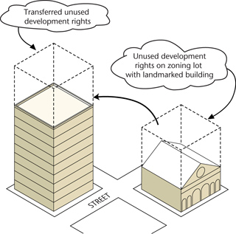
Many options for extending support to less privileged groups can be evolved. Relaxation of Floor Area Ratio (FAR) for house building projects that aim to target urban poor, initiation of Transferable Development Rights (TDR), revision of urban housing density standards in existing neighborhoods, initiation of urban re-development on the pattern of mixed land use and revitalization of already launched low income schemes are some possibilities.

Slide 33

For different forms and scales of housing, very useful work has been done in respect to construction technology. There are several housing and works related research institutions. There is a need to take stock of the research work done in these respects and examine its suitability and relevance to housing demands in various contexts.

